Slide 1


Slide 2
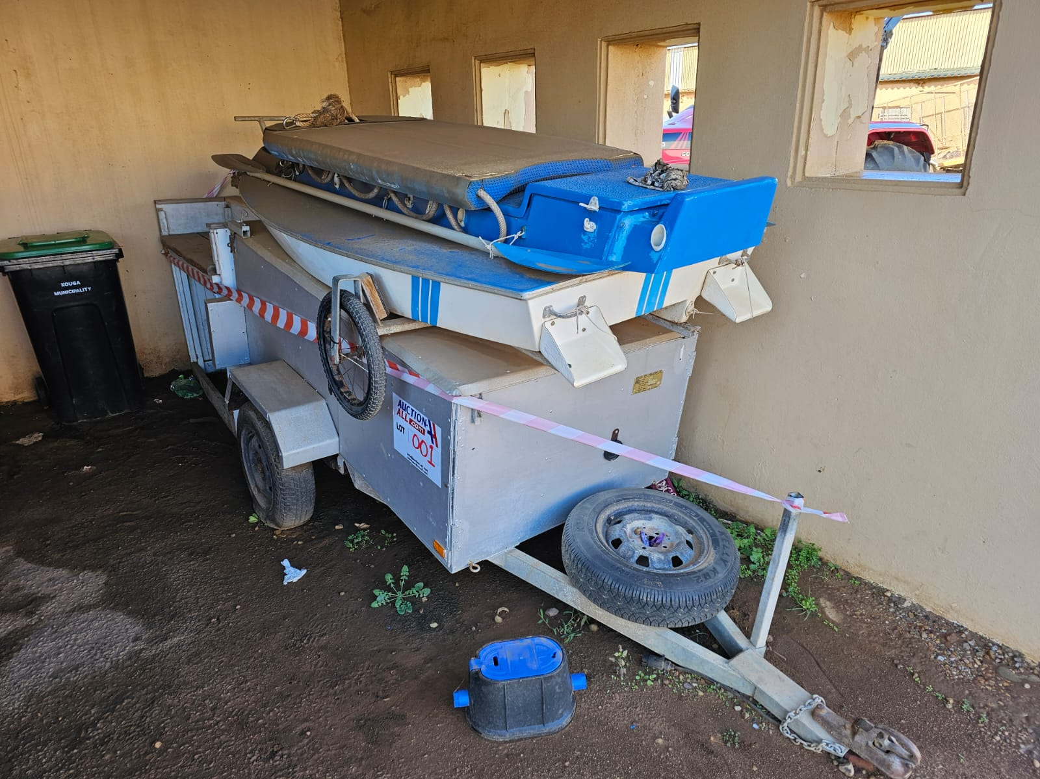
LOT 001:
Fishing Trailer with Boat

Slide 3
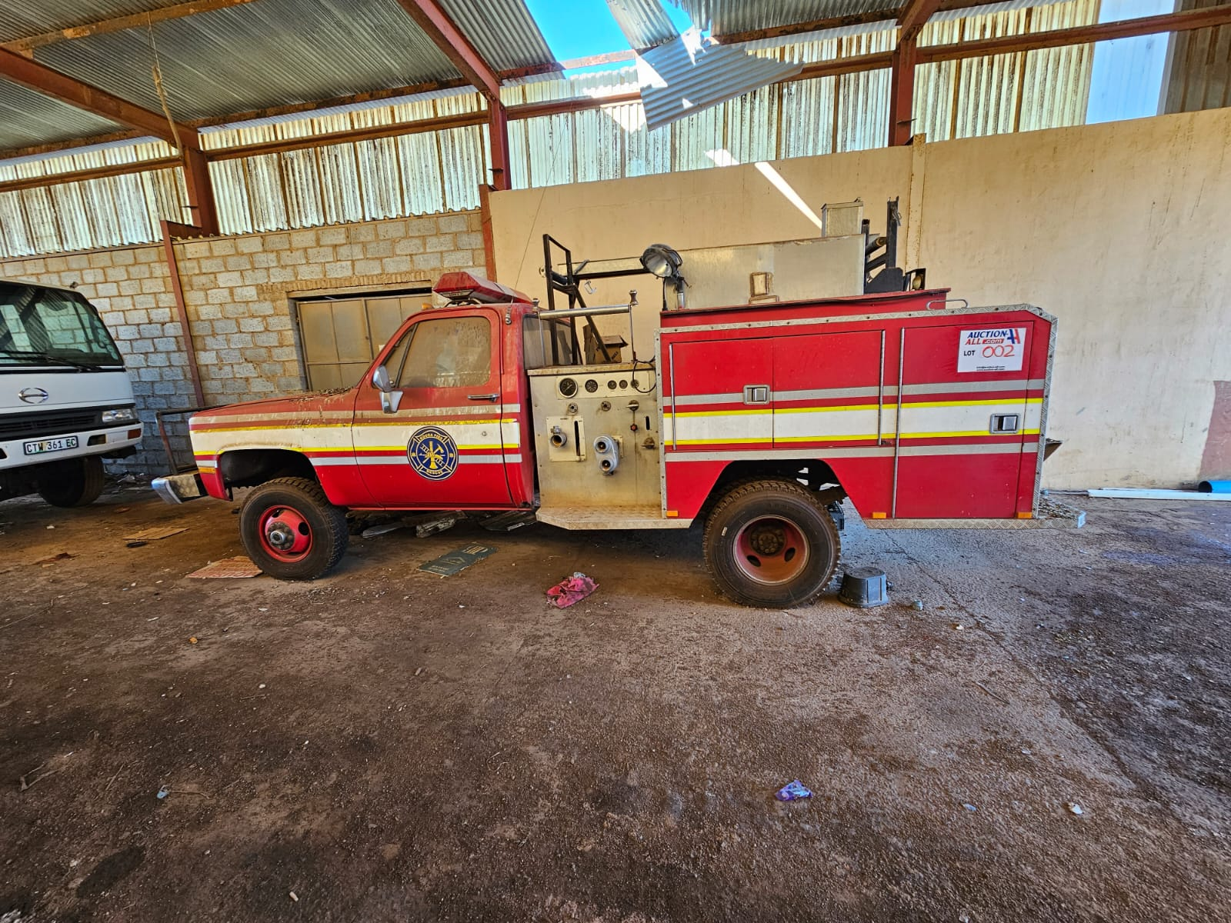
LOT 002:
GMC V8 Fire Truck

Slide 4
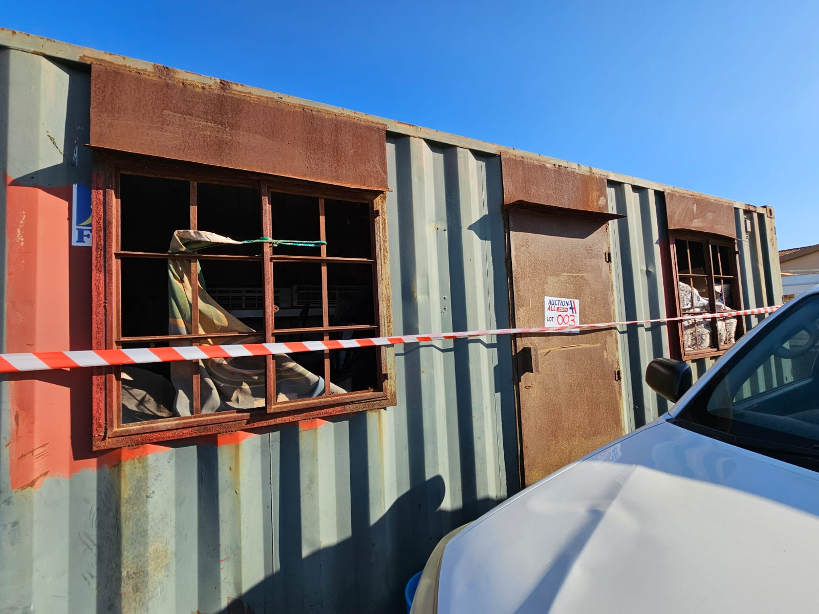
LOT 003:
Office Equipment (Container not Included)

Slide 5
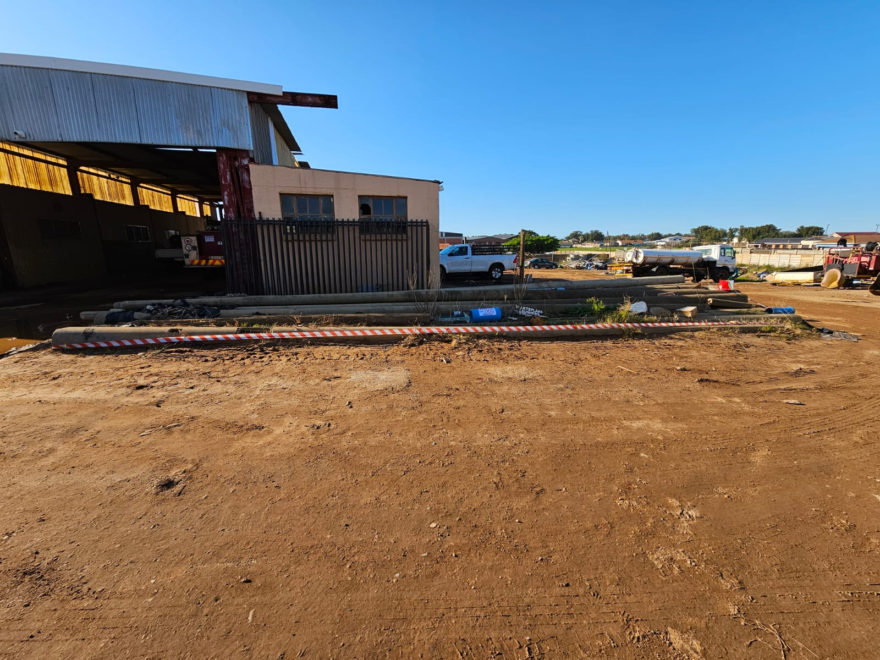
LOT 004:
Concrete Poles

Slide 6
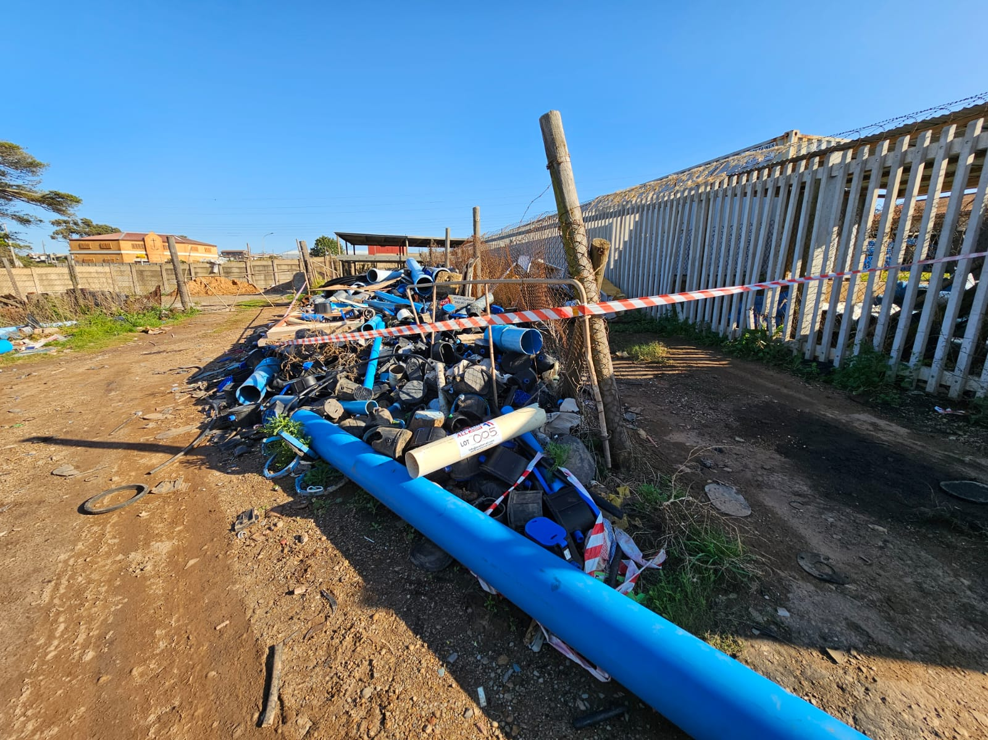
LOT 005:
Concrete Pipes and Scrap Metal

Slide 7
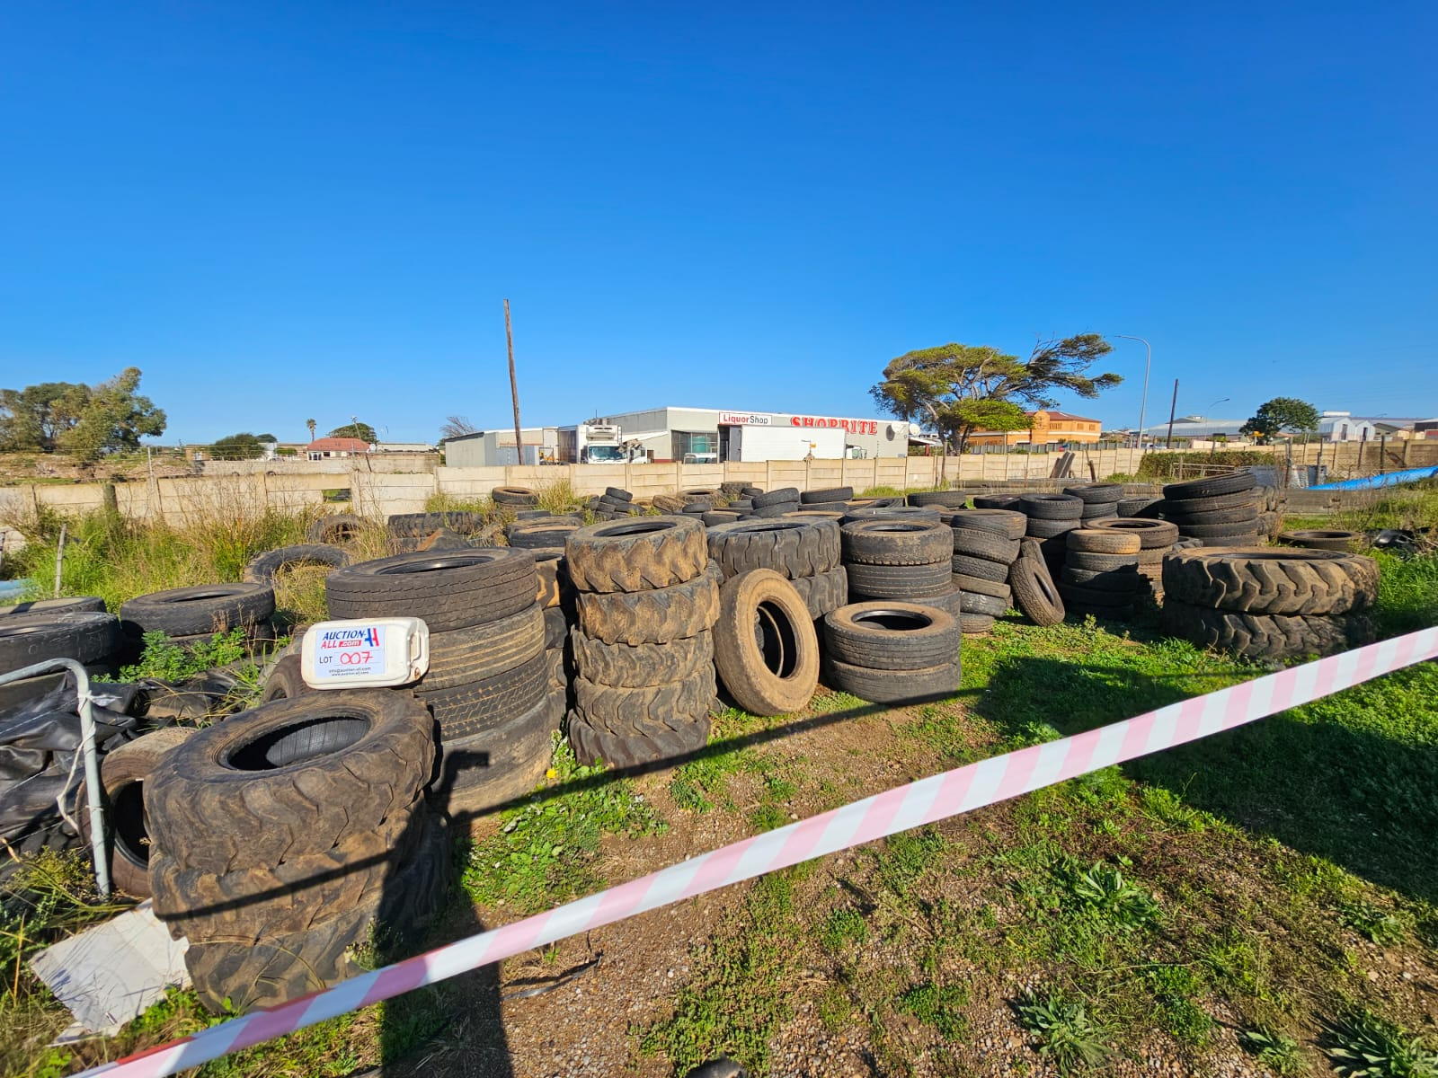
LOT 007:
Various Tyres

Slide 8
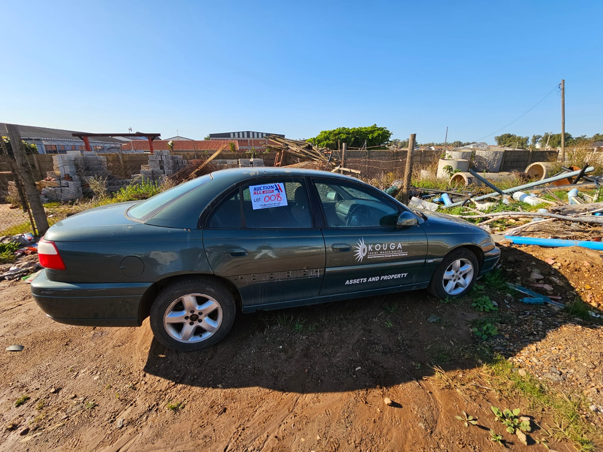
LOT 008:
Vehicle

Slide 9
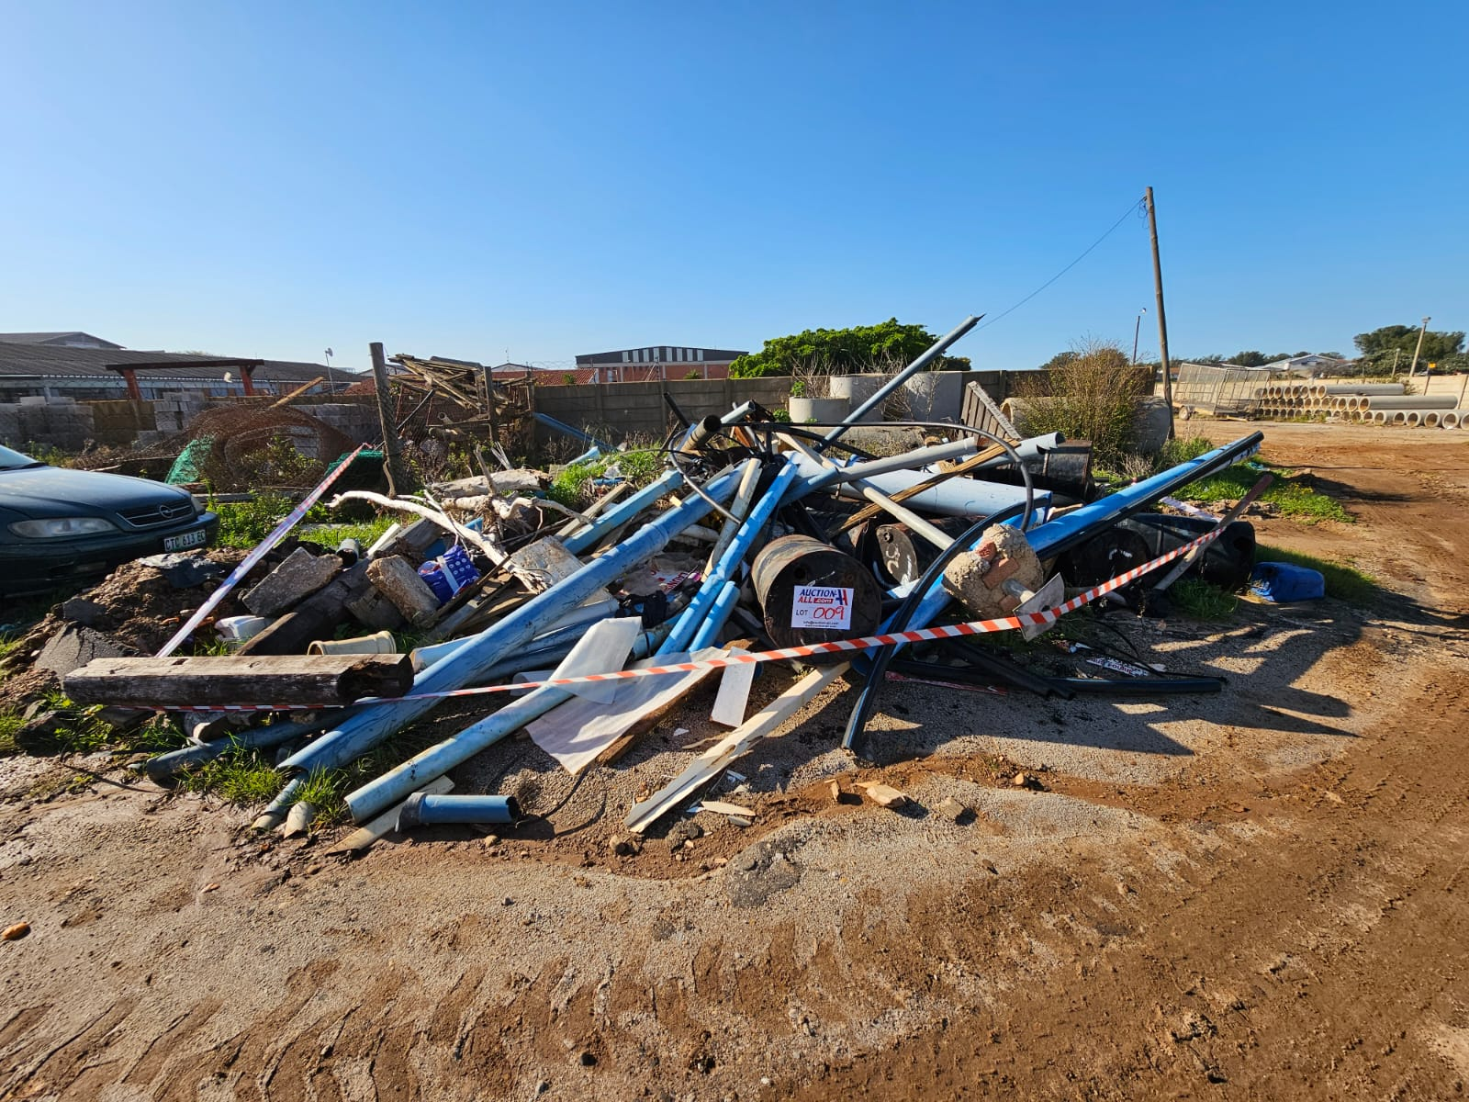
LOT 009:
Pipes and Scrap Metal

Slide 10
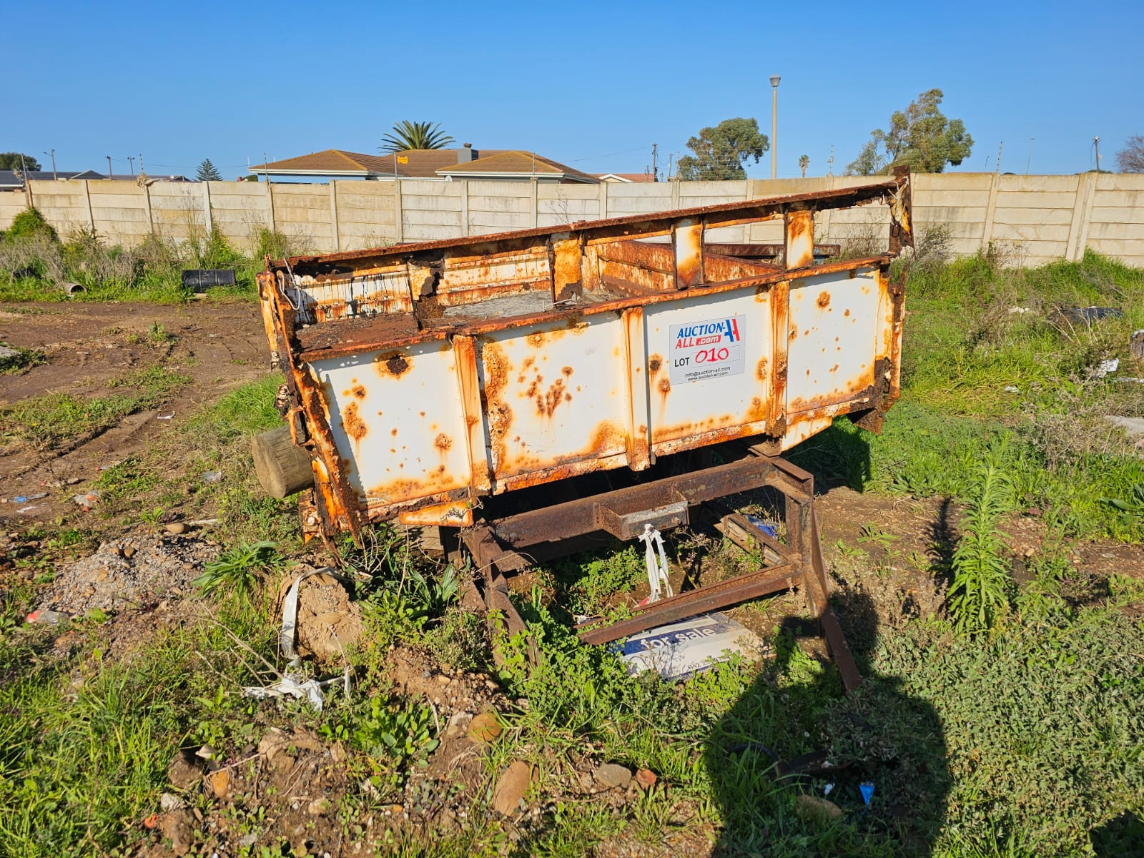
LOT 010:
Trailer

Slide 11
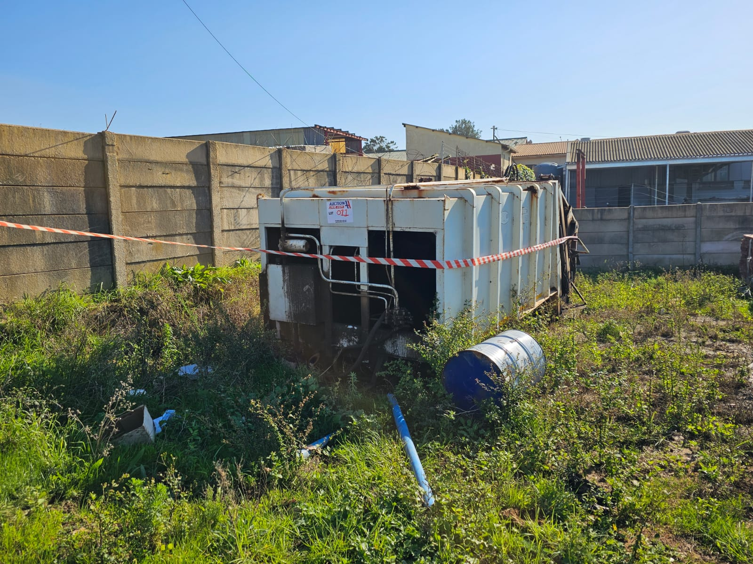
LOT 011:
Industrial Trash Compactor

Slide 12
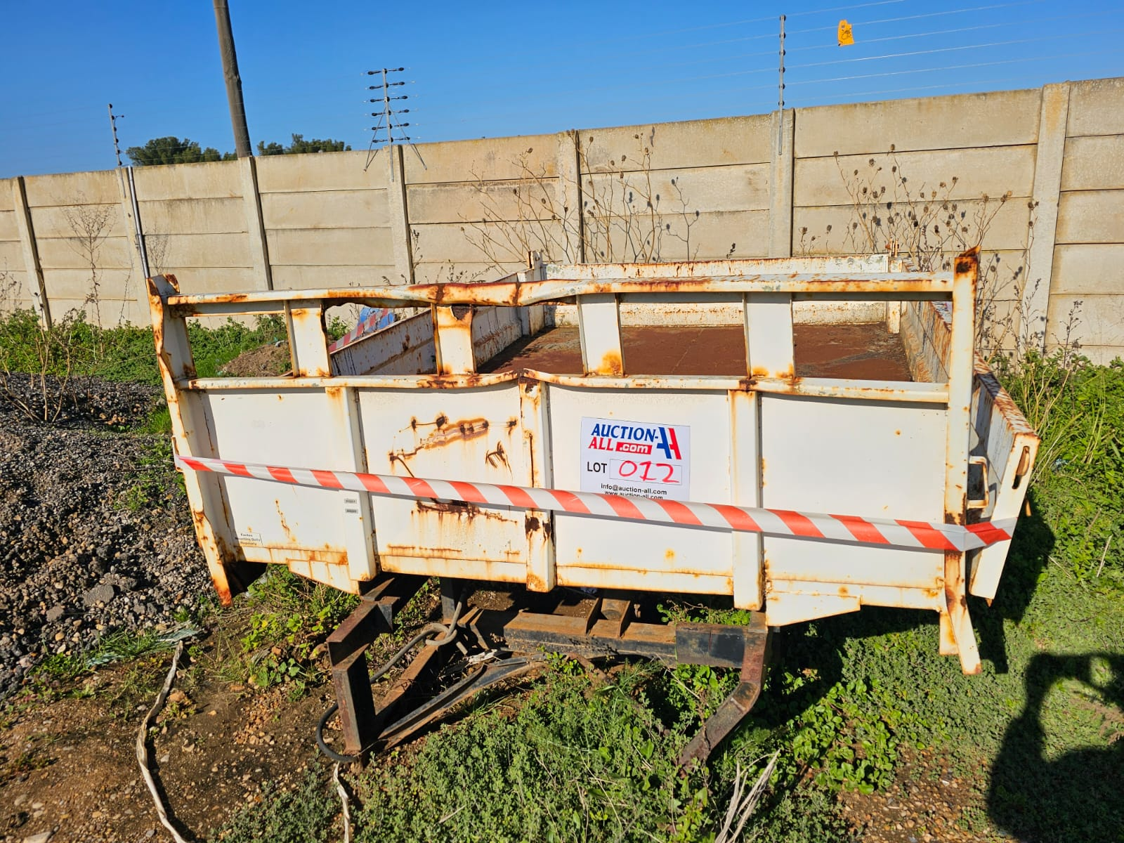
LOT 012:
Trailer

Slide 13
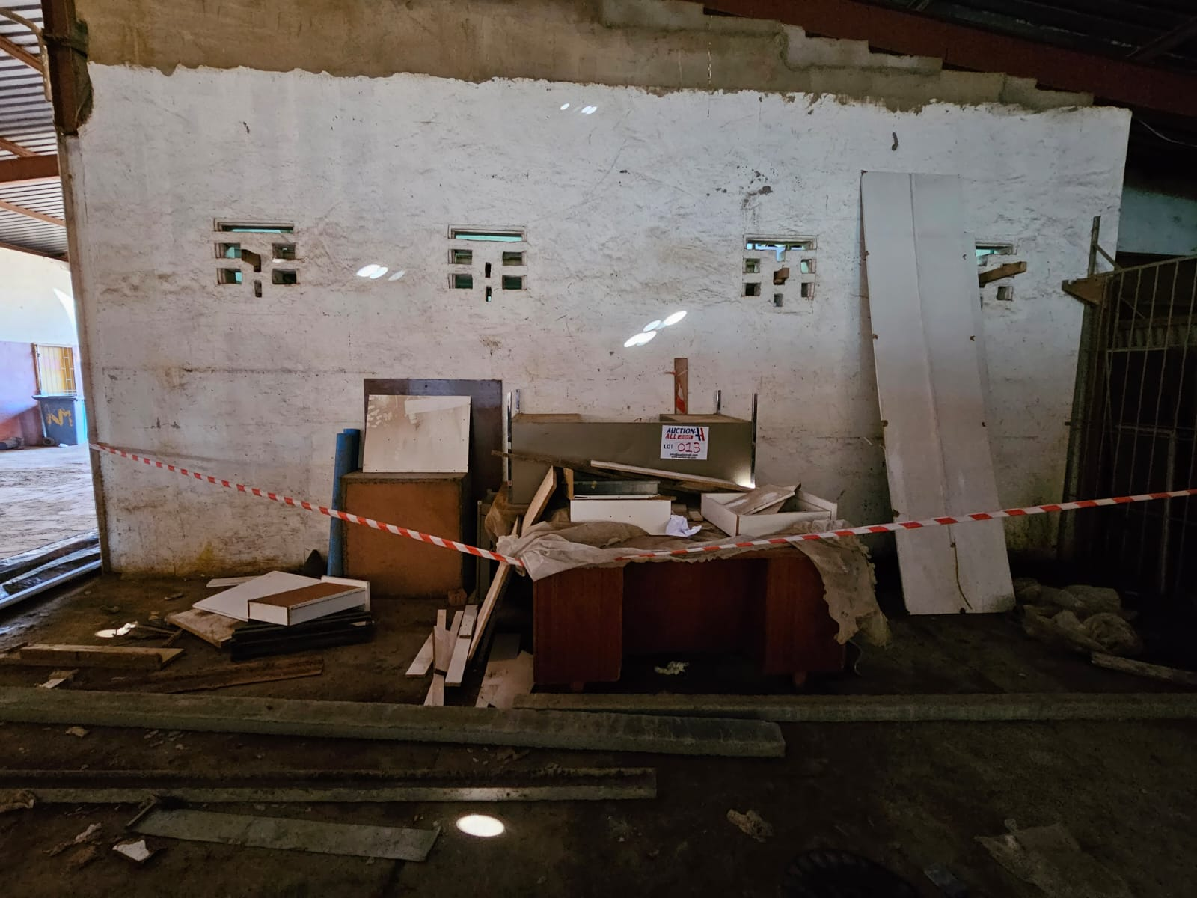
LOT 013:
Office Equipment

Slide 14
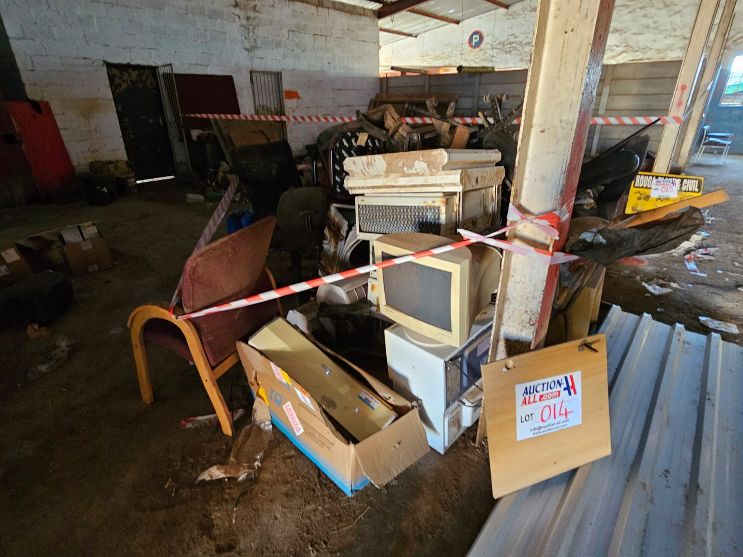
LOT 014:
Office Equipment

Slide 15
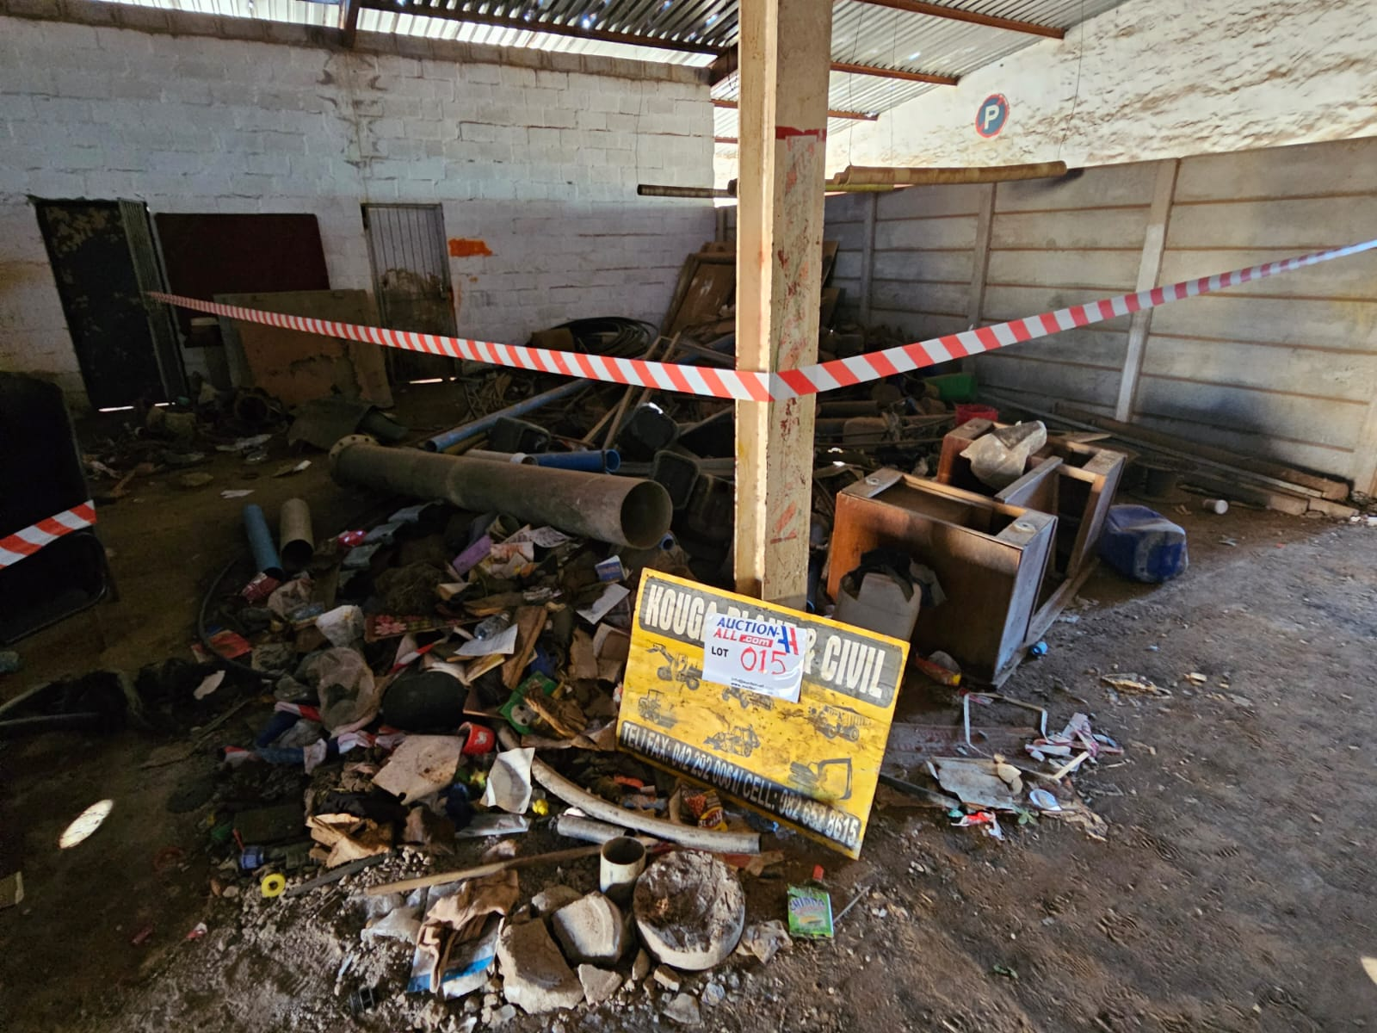
LOT 015:
Scrap Metal

Slide 16
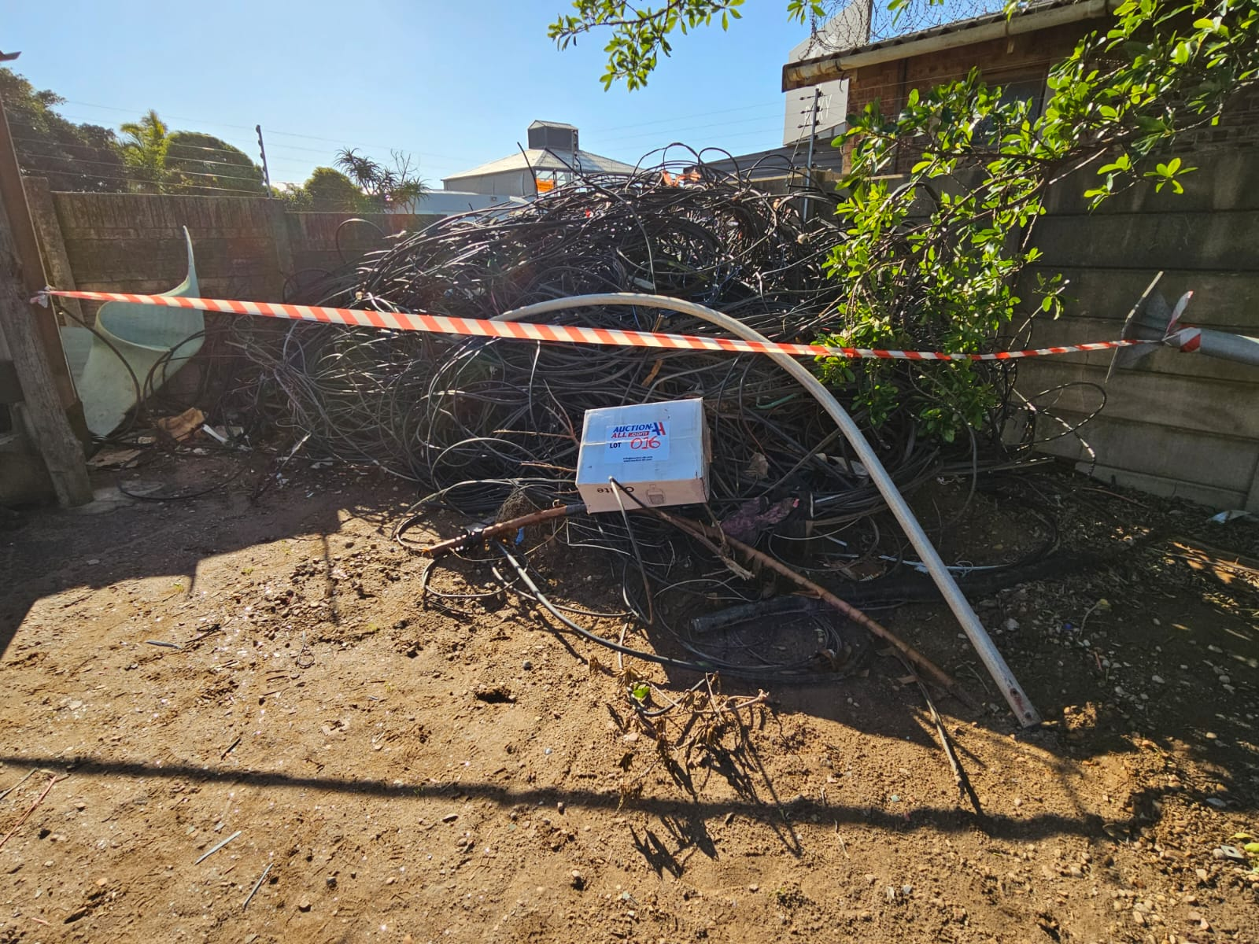
LOT 016:
Various Cables

Slide 17
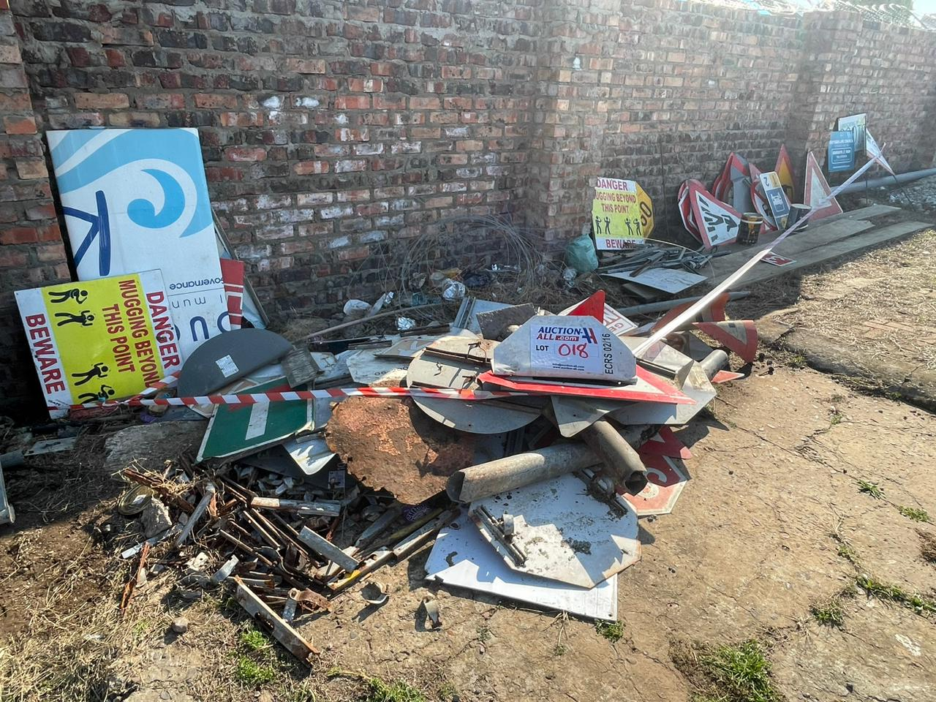
LOT 018:
Road Signs

Slide 18
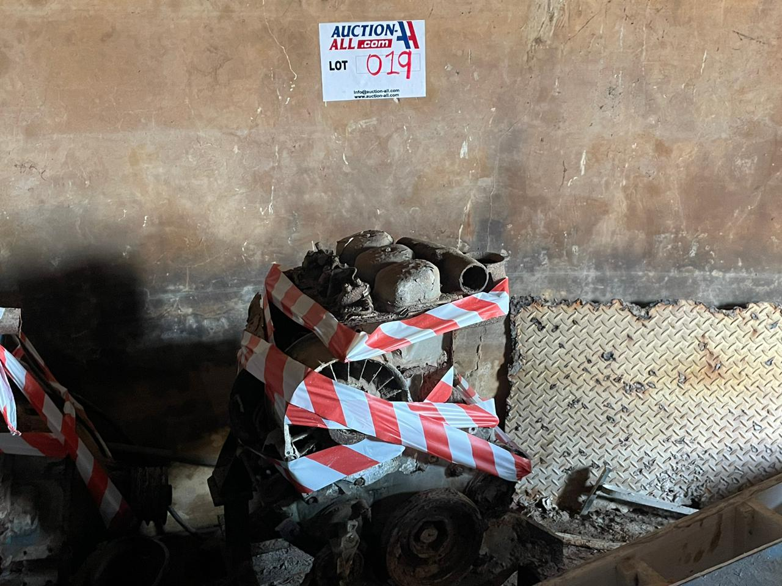
LOT 019:
Engine

Slide 19
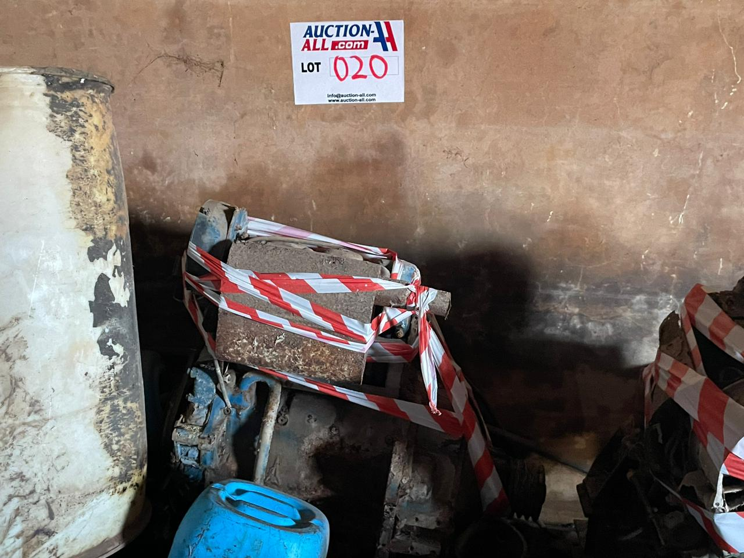
LOT 020:
Engine

Slide 20
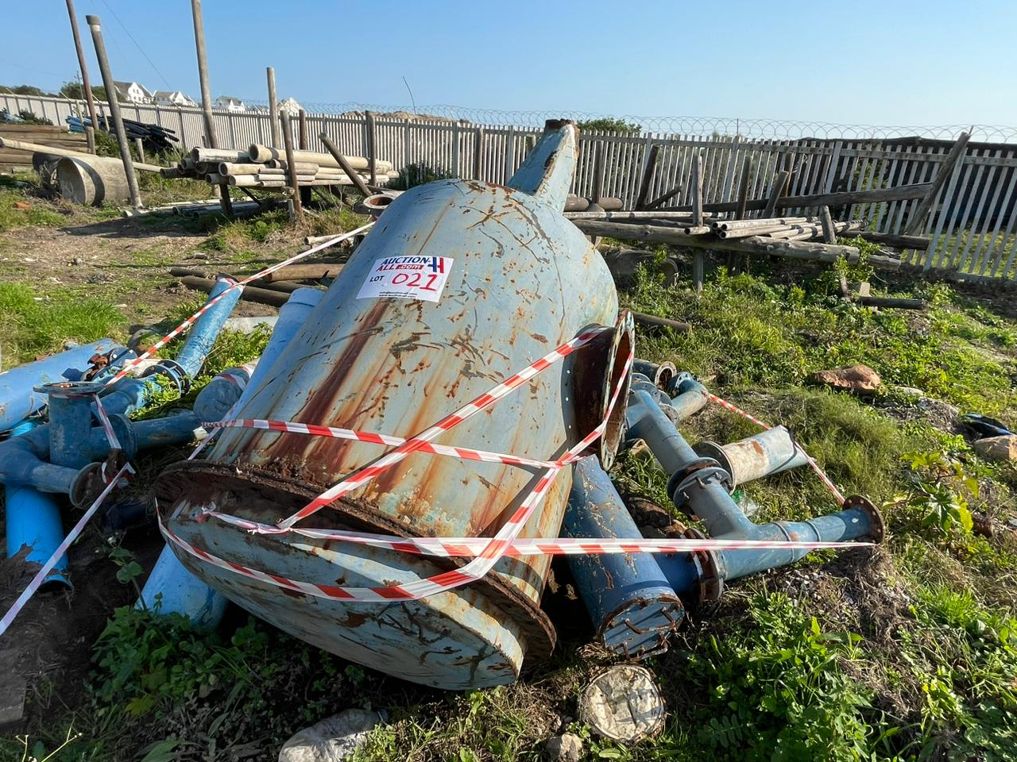
LOT 021:
Large Metal Container with Metal Pipes

Slide 21
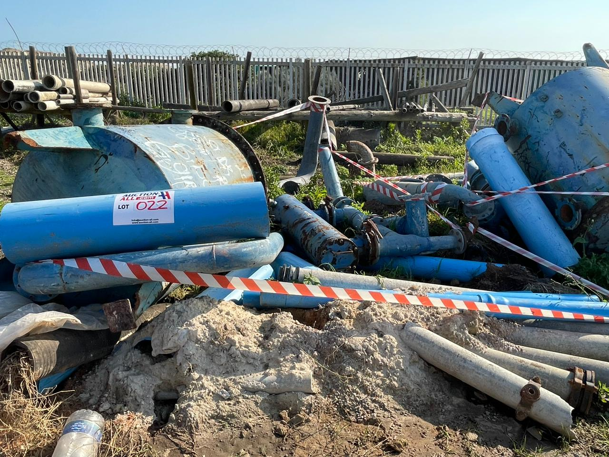
LOT 022:
Large Metal Container with Metal Pipes

Slide 22
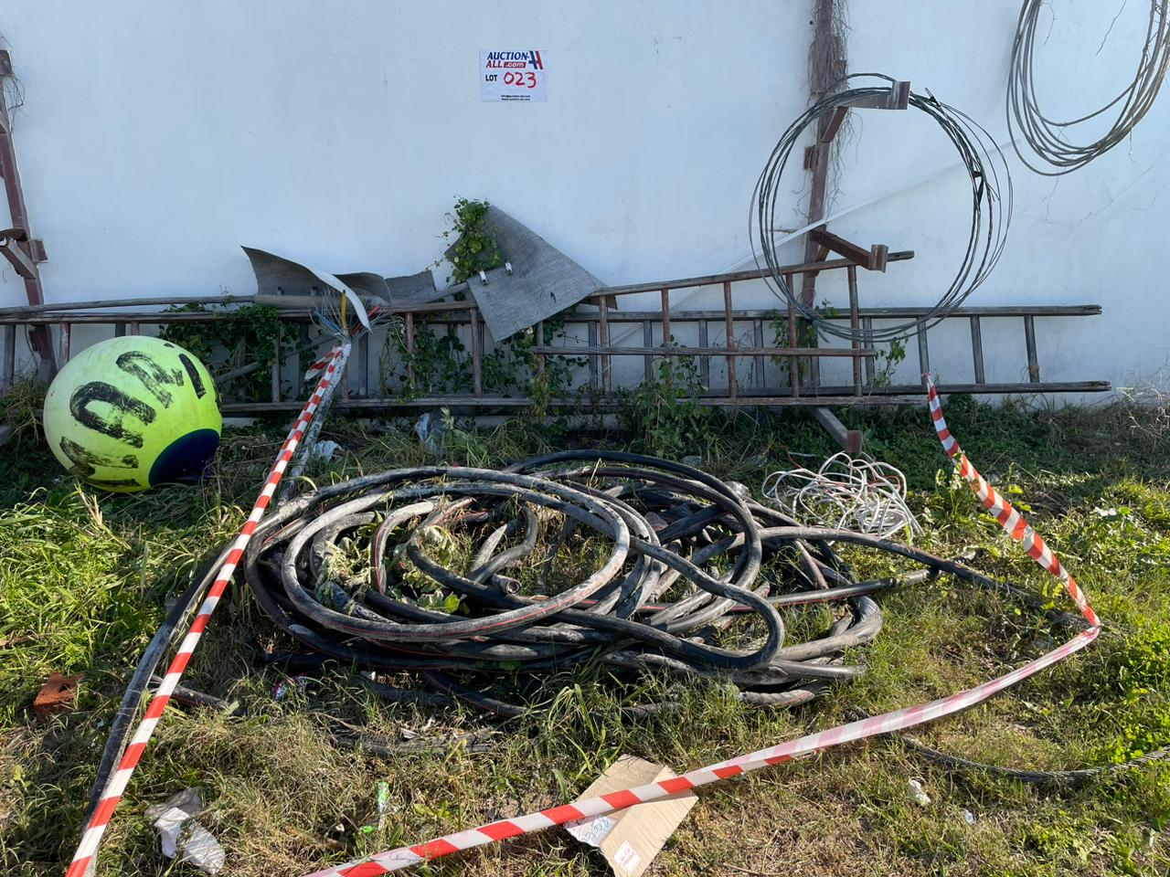
LOT 023:
Various Cables

Slide 23
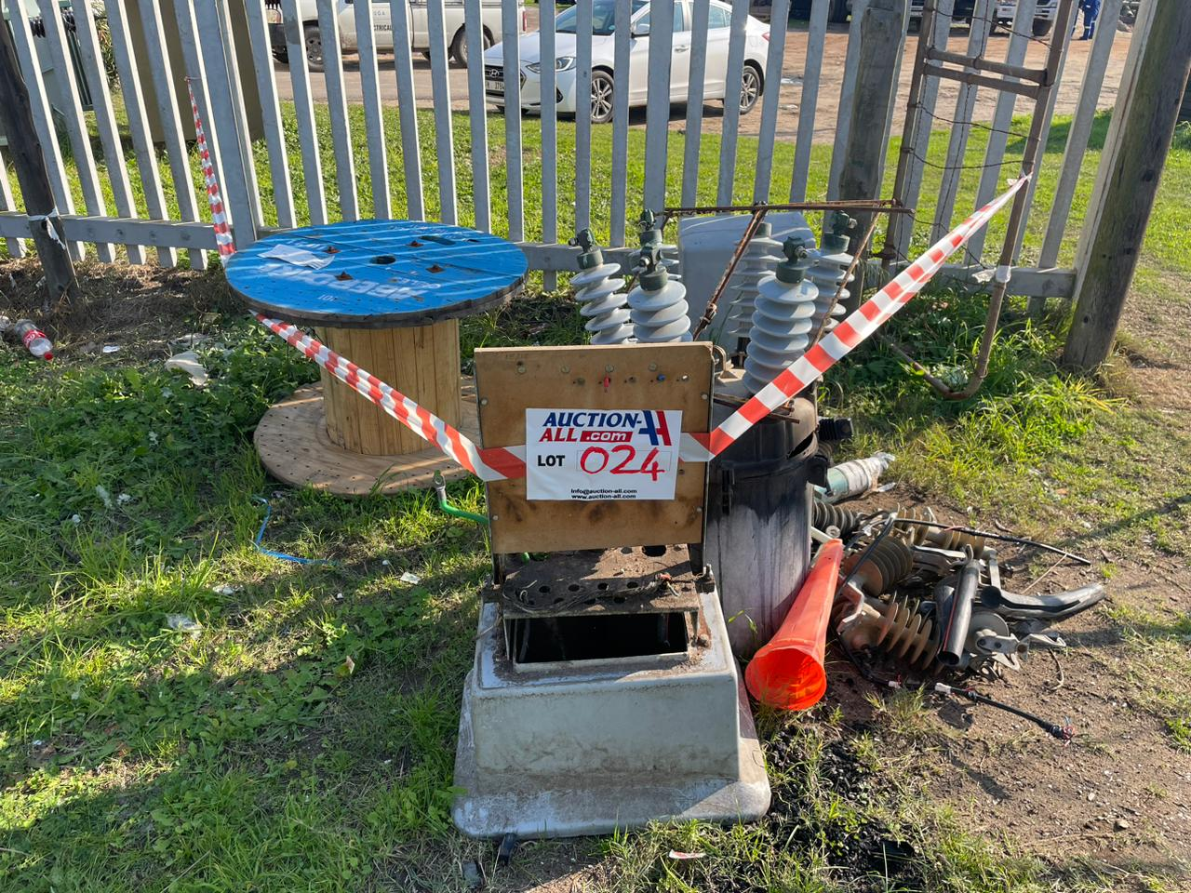
LOT 024:
Scrap Metal

Slide 24
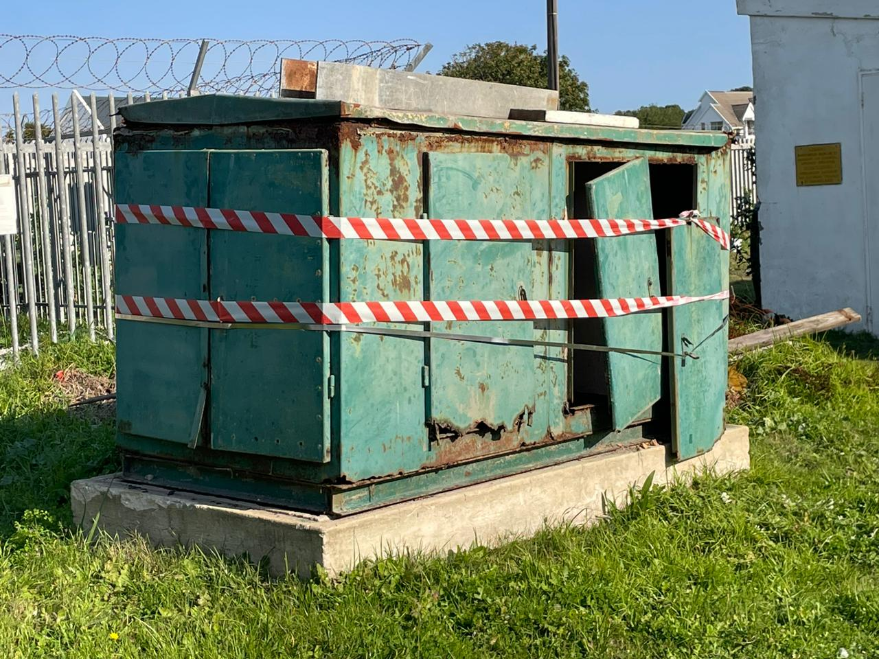
LOT 025:
Large Electrical Cabinet

Slide 25
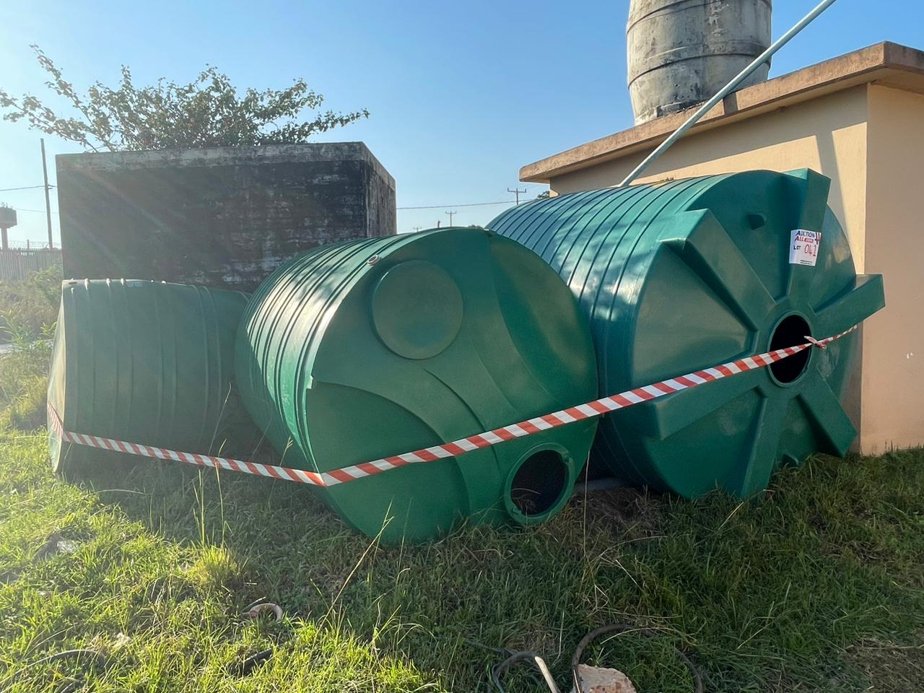
LOT 041:
Jojo Tanks

Slide 26
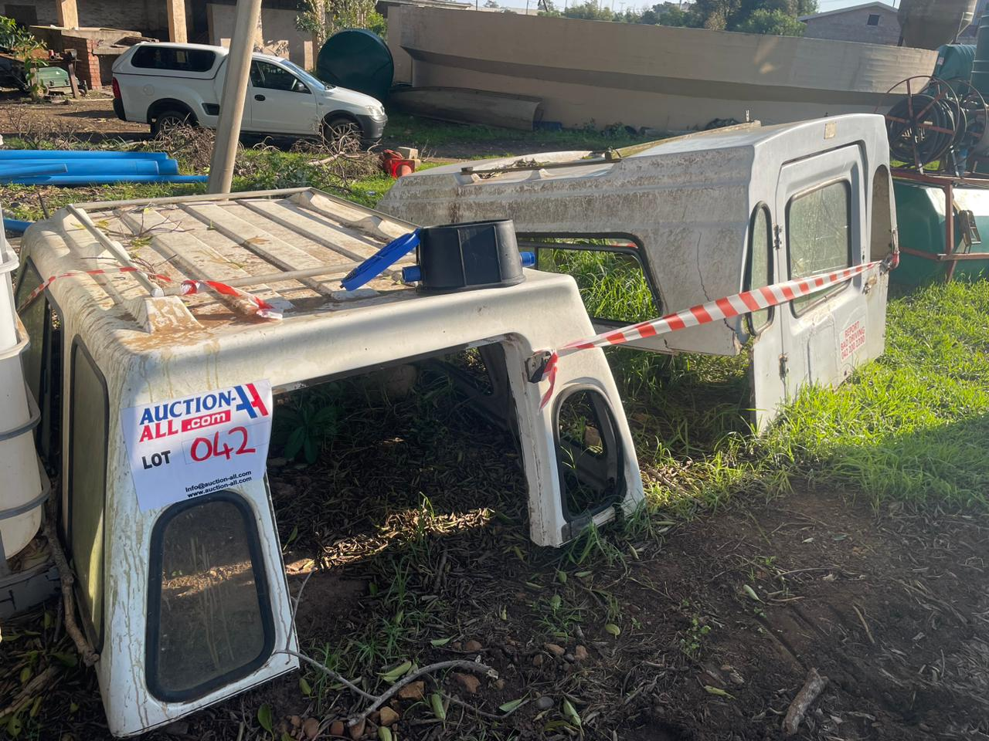
LOT 042:
Canopies

Slide 27
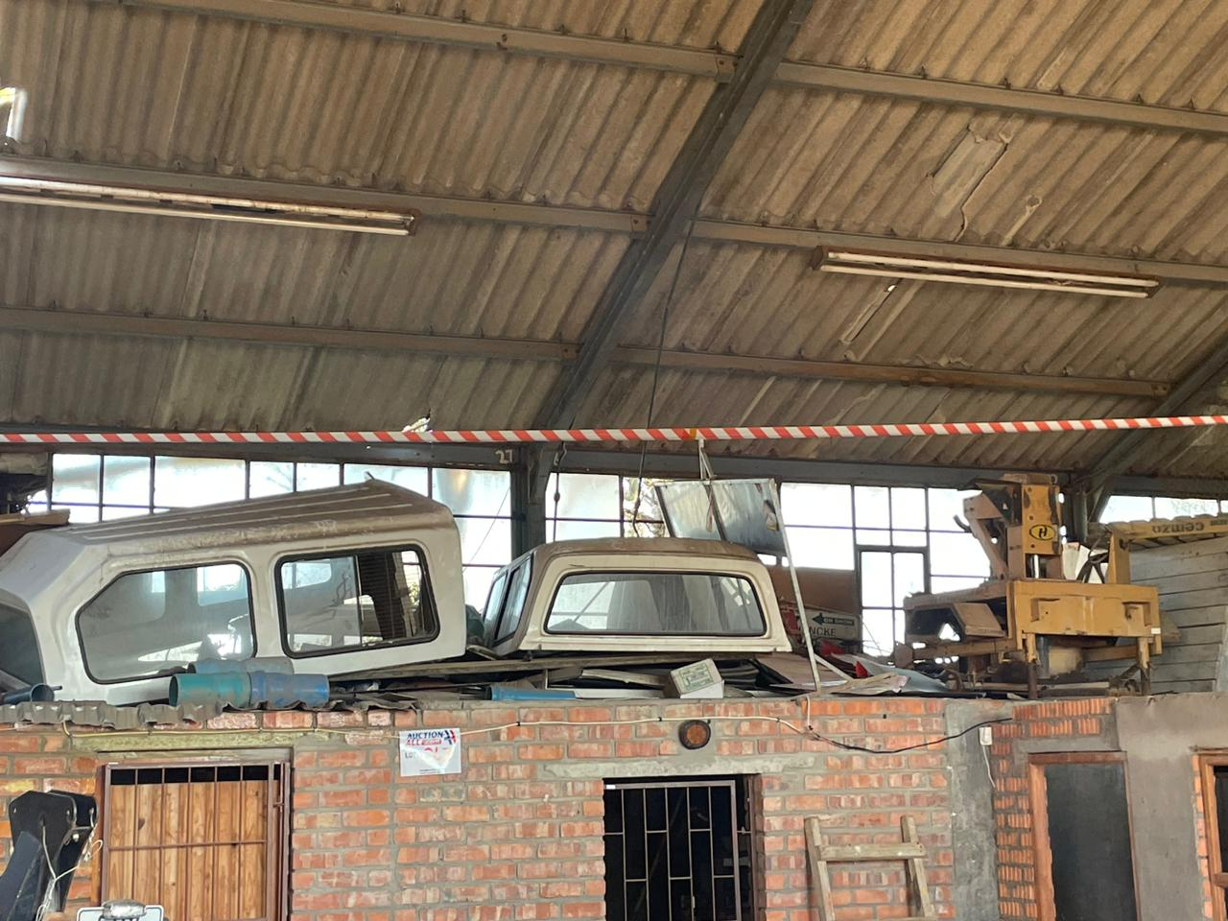
LOT 043:
Canopies and Brick Maker

Slide 28
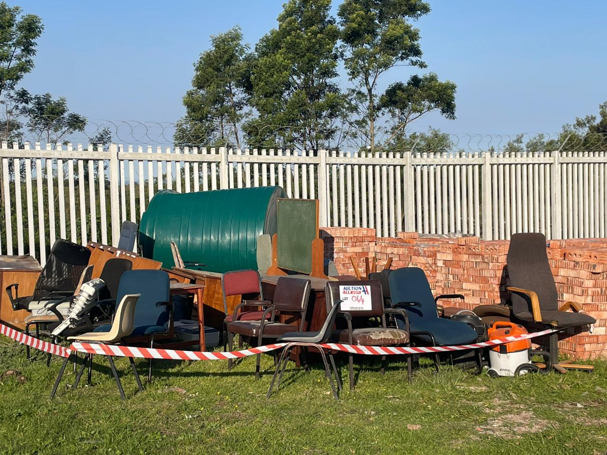
LOT 044:
Office Equipment (Jojo Tank not Included)

